Slide 1

Review Ranker (Understanding the Utility of Reviews)
Presented By:
Kunal Bhardwaj (D19016)
Veera Vignesh (D19036)
Vighnesh Tamse (D19037)
Durjay Das (D19039)

Slide 2

Problem Background
People have moved to purchasing online due to the comfort it provides.
Getting the reviews of the people before purchasing a product has been a key element for purchase.
User wants the feel of the product before making purchase, so they depend on reviews.

Slide 3


Problem
These reviews provided by the ecommerce sites today are like spider web, in which people get stuck due to the quantity of the reviews that is displayed.
For Manufacturers, reviews reflect the voice of the customer. With large volume of reviews flowing in, picking a group of customer and serving them better has become a daunting task.

Slide 4
Objective
Create a system that can automatically rank the reviews based on their utility.
Help potential buyers in selecting the product faster.
Help the customer to save a lot of time to choose whether to purchase the product or not.
Help the manufacturer to come up with new ideas which may meet the customer satisfaction based on user reviews.

Slide 5
Diagrammatic Flow of the Process
User Enters the product URL
Get Product Reviews
Processing the Reviews
Ranking the Reviews as Top Positive and Top Negative
Making Prediction on the reviews

Slide 6
Process Flow
Emoji and punctuation removal
Remove stop words and apply lemmatization
Scraping Review Text of the product
Create Tf-IDf Matrix of the unigrams that occur in more than 1% of the document
Flipkart URL*
Fitting Model Based on Unigram and important features.
Ranking Review based on Prediction
Review Rating
Scraping Other Features of the Review
Upvote
Downvote
* Limited to Products on Flipkart

Slide 7
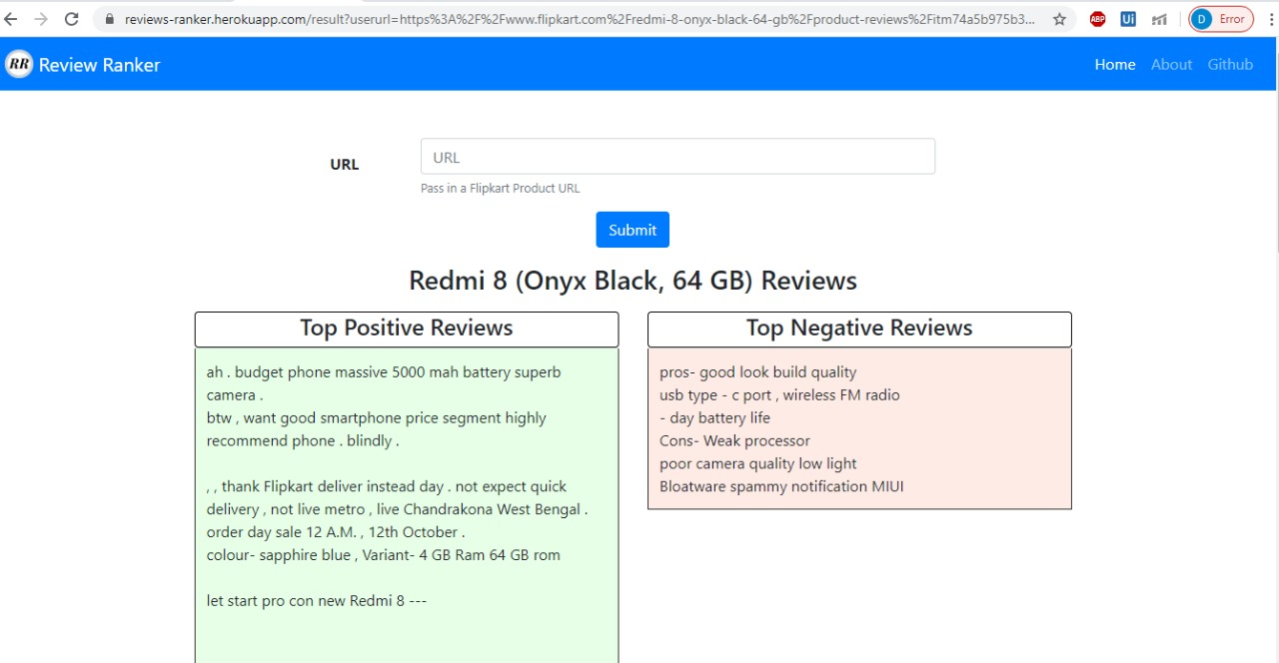
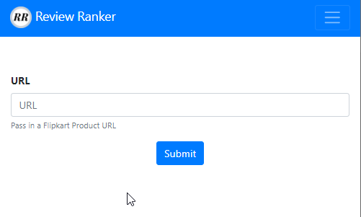
Final product
User Enters the Product URL

Slide 8


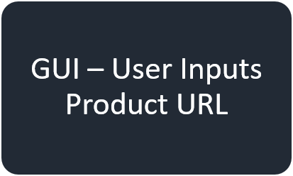


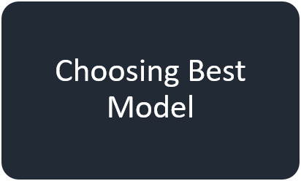
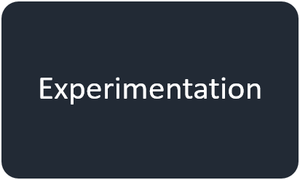
Stages of the Project

Slide 9
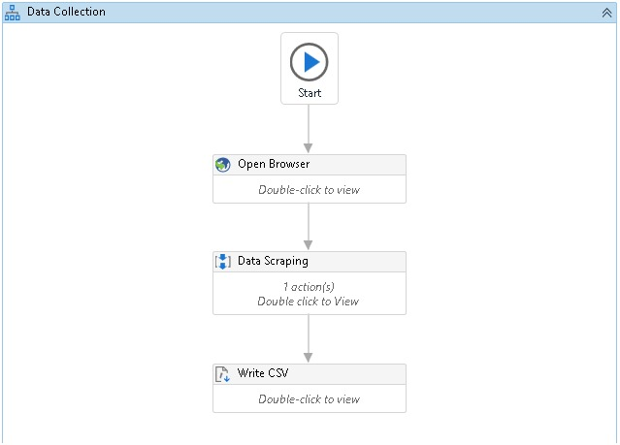
Data collection using UI-Path
Advantages
Easier to extract the reviews of any product.
User can extract all the reviews present for that product.
Limitations
User needs to install the application in his/her system.
A working knowledge of UI Path is necessary.
Process File

Slide 10
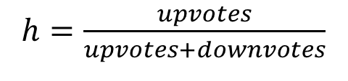
Feature Generation
Column_Name | Acronym
Review_Title | Title
Review_Text | RT
Review_Rating | RR
Num_Photos | NPh
Upvote | Up
Downvote | Down
Target Variable
Scraped Features
$h=\frac{upvotes}{upvotes+downvotes}$
Column_Name | Acronym
Len_after | LA
Len_before | LB
Num_Sentence | NS
No_QMark | NQ
No_ExMarch | NEx
No_Upper | NU
No_proper | NPr
Perc_Noun | PN
Perc_Verb | PV
Perc_Adverb | PAdv
Perc_Adj | PAdj
Target | h
Created Features

Slide 11
Experimentation
 |  | Mobile Phone |  |  | Laptops |  |  | Camera
Sr. No. | Feature Set | Random Forest | XG Boost | SVR | Random Forest | XG Boost | SVR | Random Forest | XG Boost | SVR
 |  | MAPE | MAPE | MAPE | MAPE | MAPE | MAPE | MAPE | MAPE | MAPE
1 | [RT,RR,LA,h] | 14.02 | 16.18 | 12.61 | 14.69 | 17.22 | 16.59 | 12.43 | 13.44 | 11.88
2 | [RT,RR,NS,h] | 14.43 | 16.27 | 12.38 | 14.6 | 17.02 | 15.58 | 12.68 | 13.23 | 11.69
3 | [RT,RR,LB,h] | 15.09 | 15.09 | 12.45 | 14.9 | 17.18 | 16.94 | 12.6 | 13.3 | 12.42
4 | [RT,RR,NPh,h] | 14.08 | 16.24 | 12.79 | 14.88 | 15.56 | 15.47 | 12.51 | 12.31 | 12.59
5 | [RT,RR,NPh,LB,LA,h] | 13.19 | 15.85 | 12.4 | 15.04 | 16.48 | 16.8 | 12.3 | 12.27 | 12.27
6 | [RT,PN,PV,h] | 14.9 | 17.89 | 14.01 | 15.8 | 18.89 | 16.74 | 12.64 | 12.6 | 12.23
7 | [RT,PN,PV,PAdv,h] | 14.8 | 17.34 | 14.17 | 15.66 | 18.15 | 16.68 | 12.7 | 12.37 | 12.08
8 | [RT,PN,PV,PAdv,PAdj,h] | 14.86 | 16.86 | 14.92 | 15.6 | 17.96 | 16.03 | 13.21 | 12.96 | 11.84
9 | [RT,NQ,h] | 15.4 | 17.67 | 14.12 | 14.55 | 15.29 | 15.44 | 12.5 | 12.77 | 11.65
10 | [RT,NQ,NEx,h] | 14.98 | 17.04 | 14.38 | 14.92 | 15.19 | 15.54 | 12.33 | 12.77 | 11.75
11 | [RT,NQ,NEx,NU,h] | 14.81 | 17.04 | 14.38 | 14.64 | 15.19 | 15.54 | 12.38 | 12.77 | 11.77
12 | [RT,NQ,NEx,NU,NPr,h] | 14.78 | 16.47 | 14.03 | 14.79 | 15.19 | 15.48 | 12.51 | 12.85 | 11.83
13 | [RT,NPh,NS,h] | 13.62 | 15.49 | 13.4 | 14.72 | 15.4 | 16.19 | 12.6 | 12.8 | 12.39
14 | [RT,NPh,NS,PN,h] | 13.37 | 15.61 | 13.71 | 16.01 | 17.54 | 16.88 | 12.64 | 13.17 | 11.73
15 | [RT,NPh,NS,PV,h] | 13.65 | 14.72 | 12.16 | 14.81 | 15.16 | 16.07 | 12.7 | 12.44 | 12.81
16 | [RT,NPh,NS,PN,PV,h] | 13.52 | 15.42 | 13.25 | 15.78 | 17.87 | 16.93 | 12.86 | 12.16 | 12.31
17 | [RT,NPh,NS,PAdj,h] | 13.27 | 15.94 | 13.97 | 14.22 | 15.44 | 15.72 | 13.05 | 13.43 | 12.07
18 | [RT,NPh,NS,PAdj,PN,h] | 12.95 | 15.52 | 14.95 | 15.9 | 16.74 | 16.51 | 12.94 | 12.84 | 11.78
19 | [RT,NPh,NS,PAdj,PN,PV,h] | 13.21 | 14.39 | 15.01 | 15.48 | 17.4 | 16.35 | 13.1 | 12.81 | 12.21
20 | [RT,RR,NPh,NS,PAdj,PN,h] | 12.85 | 15.38 | 15.01 | 15.78 | 16.21 | 15.86 | 12.88 | 12.99 | 11.73

Slide 12
Choosing the Best Model
Based on the Experimentation we choose Random Forest Model which had the lowest MAPE across considered product types
Review Text ,Number of Photos, Number of Sentence, Percent Adjective were the features used.

Slide 13
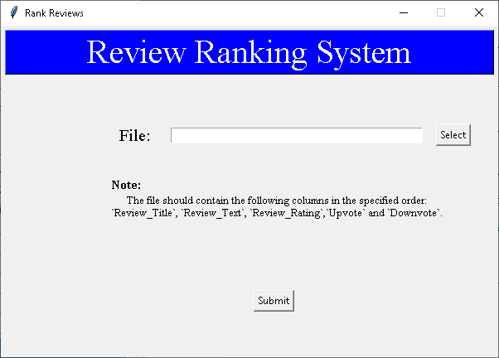

GUI – User Inputs Review File
Advantages
Simple to use front end for review ranking.
Level of abstraction provided to the user.
Limitations
User has to run the UI-Path Process and save the reviews to excel file to get the ranking of the reviews.
User has to follow the naming convention and order of the features passed.

Slide 14
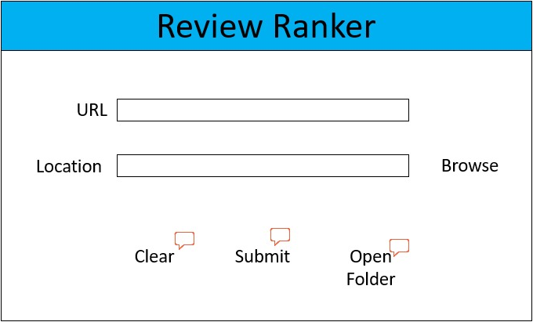
GUI – User Provides Product URL
Advantages
Takes care of review extraction and processing.
User manual task greatly reduced
Limitations
Time to get the results is high
Have to install application to get the ranked positive and negative reviews.

Slide 15
Creating a Flask Application
Advantages
Hosted application needs no installation.
On the go results with just a click of a button.
User Enters the Product URL
Limitations
User has to copy and paste the product URL into the website
Ranking is based on 4 pages of the scraped reviews.
https://reviews-ranker.herokuapp.com/

Slide 16
Deployment
Advantages
Can be open sourced since its deployed on Heroku.
Multiple users can access at the same time.
Limitations
Currently can process only Flipkart reviews
Reliability of the server being online is low
Notes:
In the URL section, user needs to enter the URL of the product from the Flipkart page they wish to get reviews of.
On click of the Submit button, the system scrapes the reviews from the URL provided, performs the NLP techniques, segments the reviews as positive and negative and then ranks the reviews.
The ranked top positive and top negative reviews are then displayed on the screen.
This web application is user-friendly and can be accessed in both mobile device and desktops or laptops.

Slide 17
Challenges/ Future Scope
The application is currently designed to work only for Flipkart but can be scaled up to other online ecommerce sites like Amazon, Paytm, etc.
Currently the application works for only one product at a time. It can be enhanced to work on multiple product and compare their reviews at the same time
Currently Review Ranker is available as a software(.exe) and a website. The application can be converted in plugins (extensions) which can be used directly on the browser itself
The review ranker can be enhanced to identify whether the review provided by the user is up to the standards and predict how helpful his review could be in the future

Slide 18
Conclusion
The Review Ranker helps the customer to just read those reviews that are important. This will lead to save a lot of time for customers
The manufacturers can also use the application to identify the shortcomings of their product and target the real need of the customers
In this internet world where the reviews are piling up everyday, Review Ranker will surely be a gamechanger for review readers in the long run.

Slide 19
Acknowledgment

Slide 20


Slide 21


